Slide 1
Time dependent model
Report

Slide 2
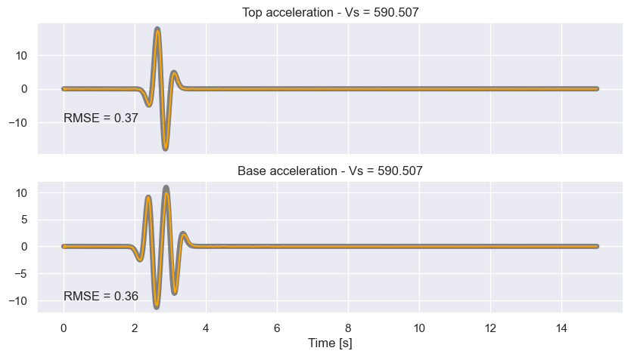
The model
Vs
Conv1D layers
LSTM layers
FC layers

Slide 3
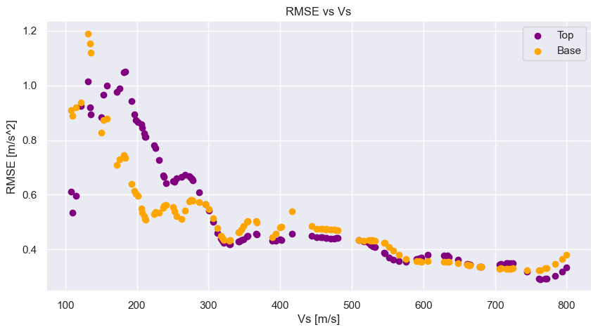
Preliminary results:

Slide 4
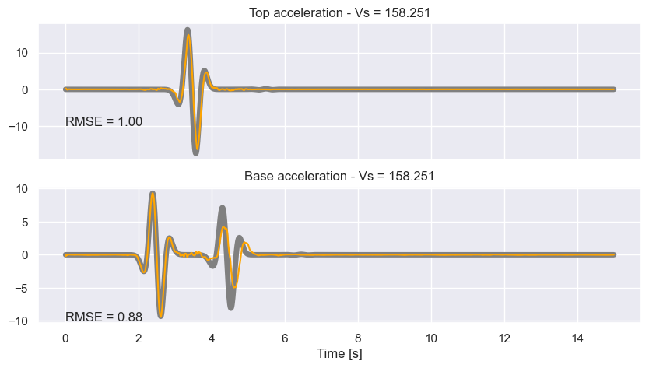
Preliminary results

Slide 5
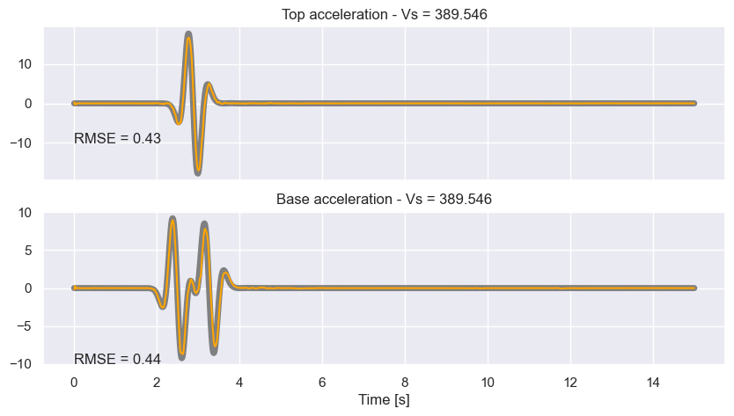
Preliminary results

Slide 6
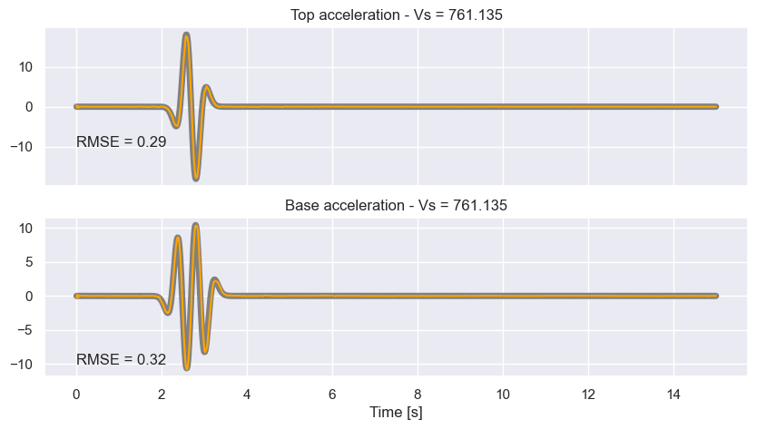
Preliminary results

Slide 7
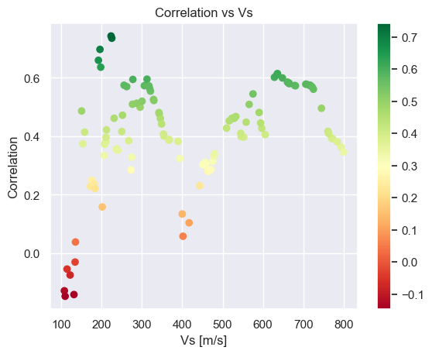
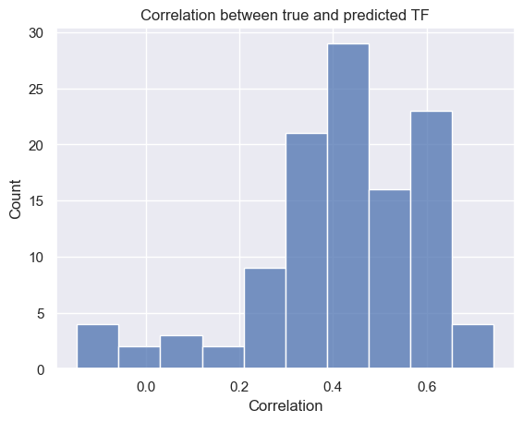
Transfer Functions

Slide 8
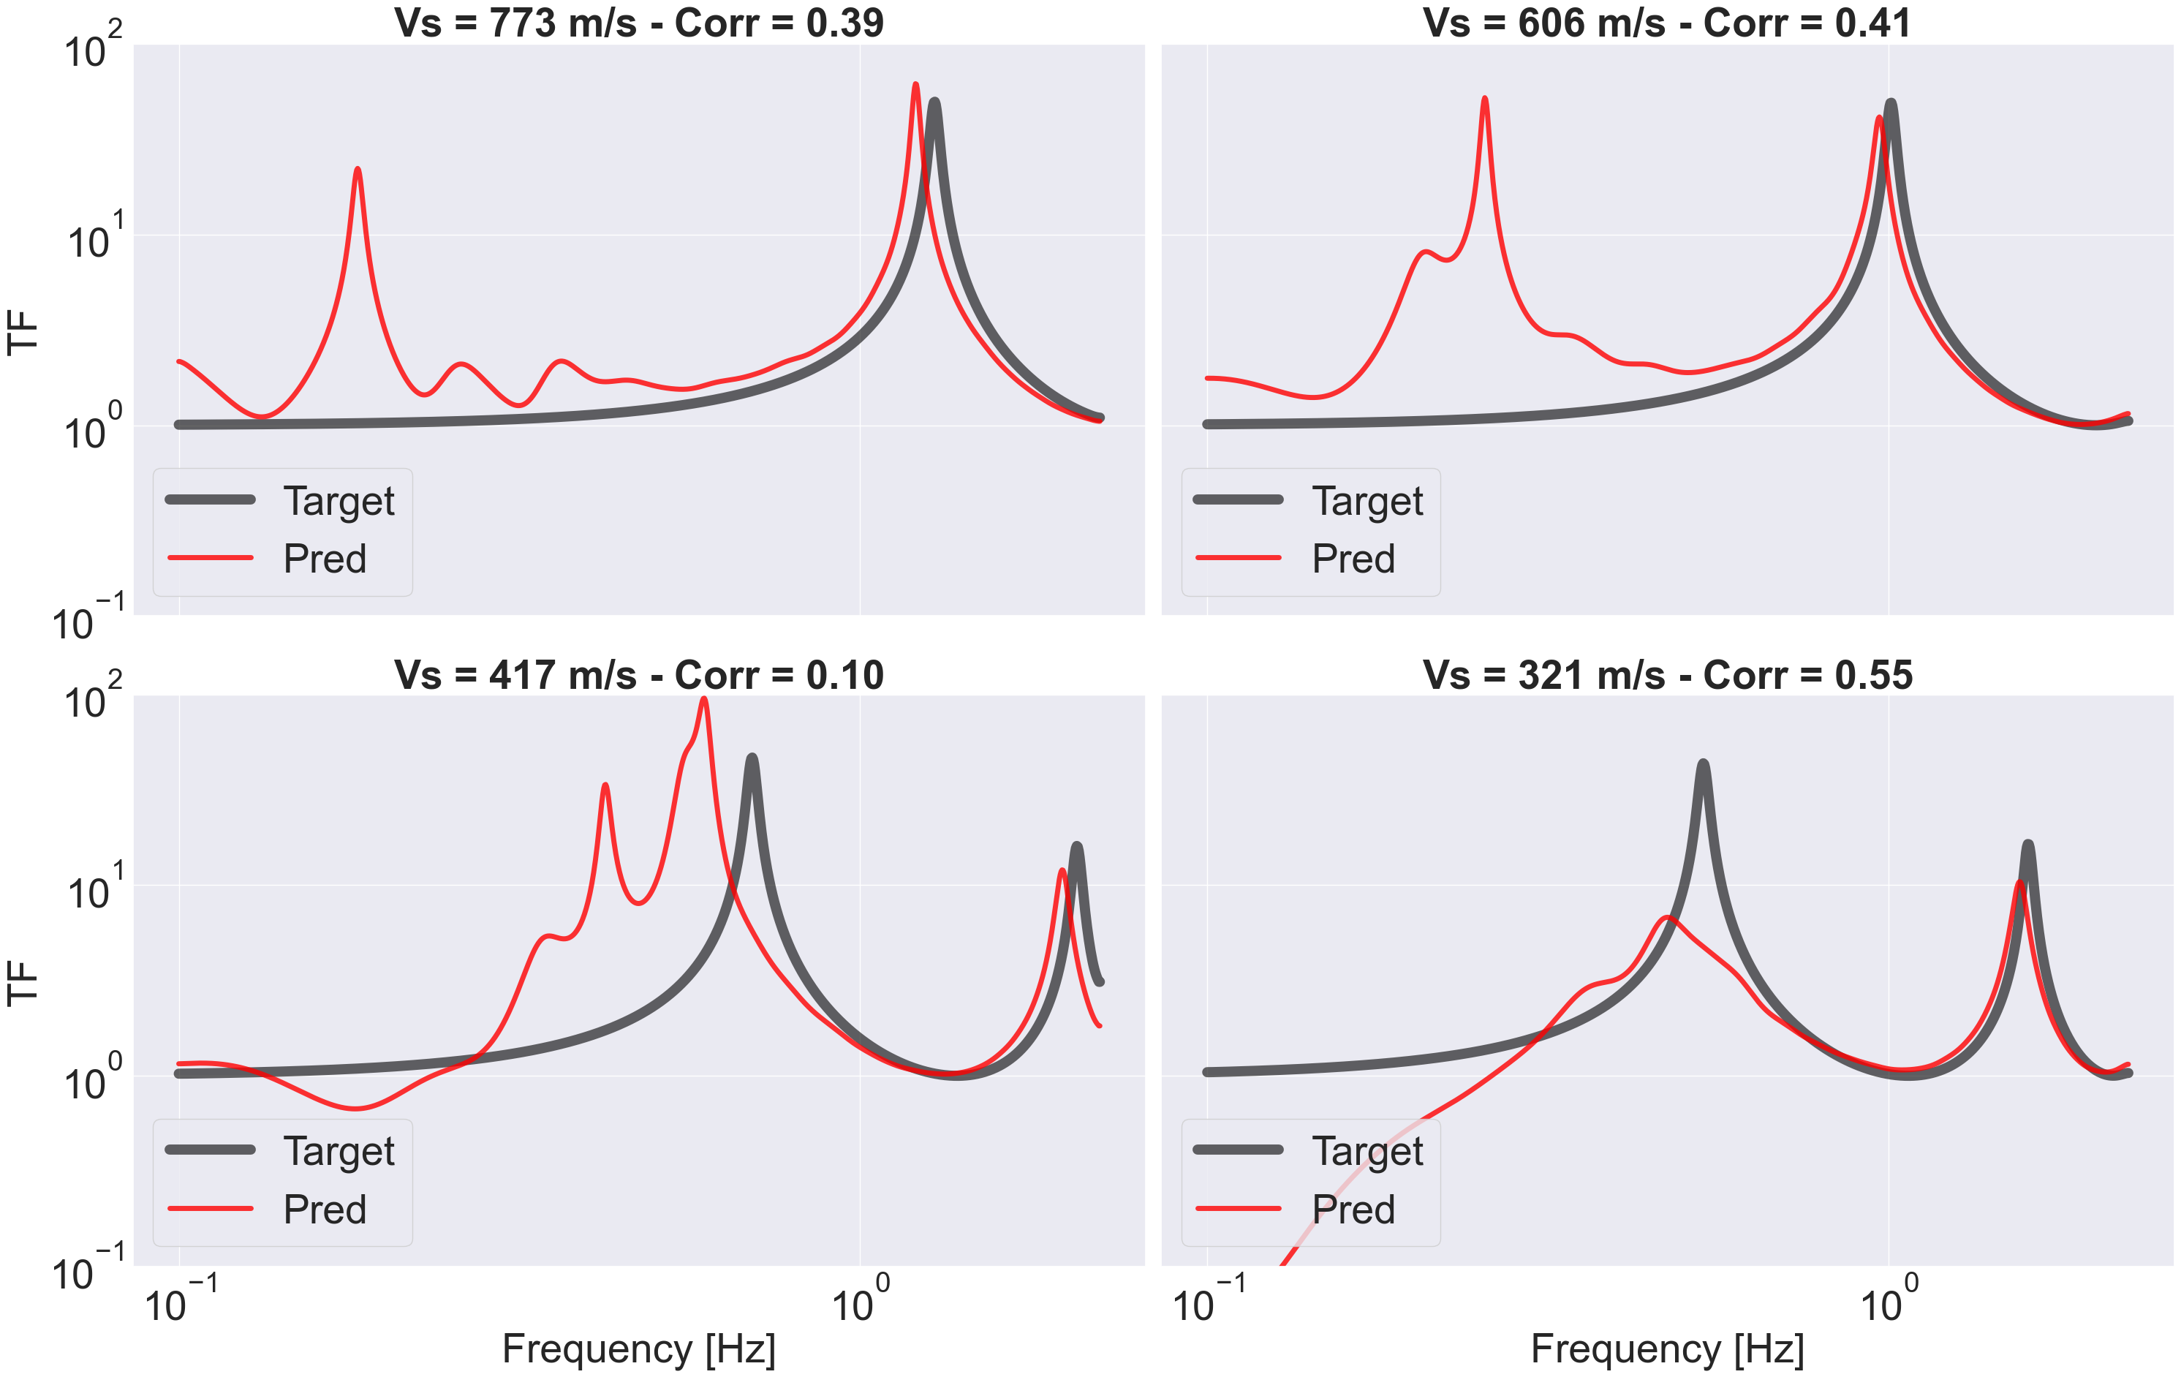

Slide 9
